Slide 1


K. RAMAKRISHNAN COLLEGE OF ENGINEERING
(AUTONOMOUS)
SAAS SUBSCRIPTION AND ENTITLEMENT PLATFORM
Presented by,
Name : SANJAI S
Register No. : 8115U23IT303
Roll. No. : LITA2365
Year & Section : 3rd YEAR - IT A
Course Code : ITC1327
Course Name : FULL STACK DEVELOPMENT
Date: 06.05.2026

Slide 2
AGENDA
Objective
Abstract
Literature Survey
Existing System
Proposed System
Modules
Workflow
Output
Sample Coding
Conclusion
Future Scope
References

Slide 3
OBJECTIVE
The objective of this project is to develop an API-first SaaS Subscription and Feature Entitlement Platform that allows external applications to integrate subscription management, feature access control, usage tracking, and entitlement verification through secure APIs. The system enables app owners to create plans, assign features, generate API keys, manage subscriptions, and dynamically control user access without building their own subscription infrastructure.

Slide 4
INTRODUCTION
The SaaS Subscription & Feature Entitlement Platform is a centralized API-driven service provider system designed for modern applications. Similar to platforms like Stripe Billing and Razorpay, this system allows application owners to integrate subscription and feature access management into their applications using secure APIs. The platform supports multi-tenant architecture where each application owner operates independently with isolated data and configurations. It provides functionalities such as plan creation, API key generation, subscription management, usage tracking, feature entitlement verification, and payment integration support. The system simplifies SaaS infrastructure development and enables real-time access control for premium application features.

Slide 5
LITERATURE SURVEY
Name of Author(s) | Title | Year of Publication | Pros | Cons
Stripe Documentation Team | Stripe Billing System | 2023 | Powerful subscription APIs | Complex pricing structure
PayPal Developers | Subscription APIs | 2022 | Global payment integration | Limited entitlement control
Firebase Team | Firebase Authentication & Access Control | 2021 | Easy integration | Limited SaaS subscription support
Razorpay Developers | Razorpay Subscription APIs | 2023 | Supports recurring billing | Requires custom feature management
Multiple SaaS Researchers | Multi-Tenant SaaS Architectures | 2020-2024 | Scalable architecture | Requires advanced security handling

Slide 6
EXISTING SYSTEMS
Currently, many applications build subscription management systems independently using custom backend logic and payment integrations. Most systems focus mainly on payments and do not provide centralized entitlement management. Feature access is often hardcoded into applications, making maintenance and scaling difficult.
Disadvantages
Subscription logic duplicated across applications
No centralized entitlement management
Difficult feature access handling
Complex scaling and maintenance
Limited API-based integration support
Poor usage tracking and analytics

Slide 7
PROPOSED SYSTEMS
The proposed system is a centralized API-first SaaS platform for managing subscriptions, feature access, and usage tracking. App owners register as tenants, generate API keys, create plans and features, and integrate the platform APIs into their applications. The system dynamically validates feature access using real-time entitlement APIs and tracks user usage based on subscription limits.
Advantages
API-first scalable architecture
Multi-tenant SaaS infrastructure
Real-time feature entitlement verification
Secure API key authentication
Centralized subscription management
Easy integration for external applications
Dynamic feature access control
Usage tracking and analytics support

Slide 8
MODULES
Authentication Module
Handles tenant authentication and secure API access.
API Key Management Module
Generates and manages API keys for tenant applications.
Subscription Management Module
Creates and manages subscription plans and user subscriptions.
Feature Entitlement Module
Validates user access to premium features dynamically.
Usage Tracking Module
Tracks API calls and feature usage for every user.
Multi-Tenant Management Module
Maintains isolated environments for multiple application owners.
Payment Integration Module
Supports integration with Razorpay or PayPal for subscription activation.
Analytics Dashboard Module
Provides API usage statistics and subscription insights.

Slide 9
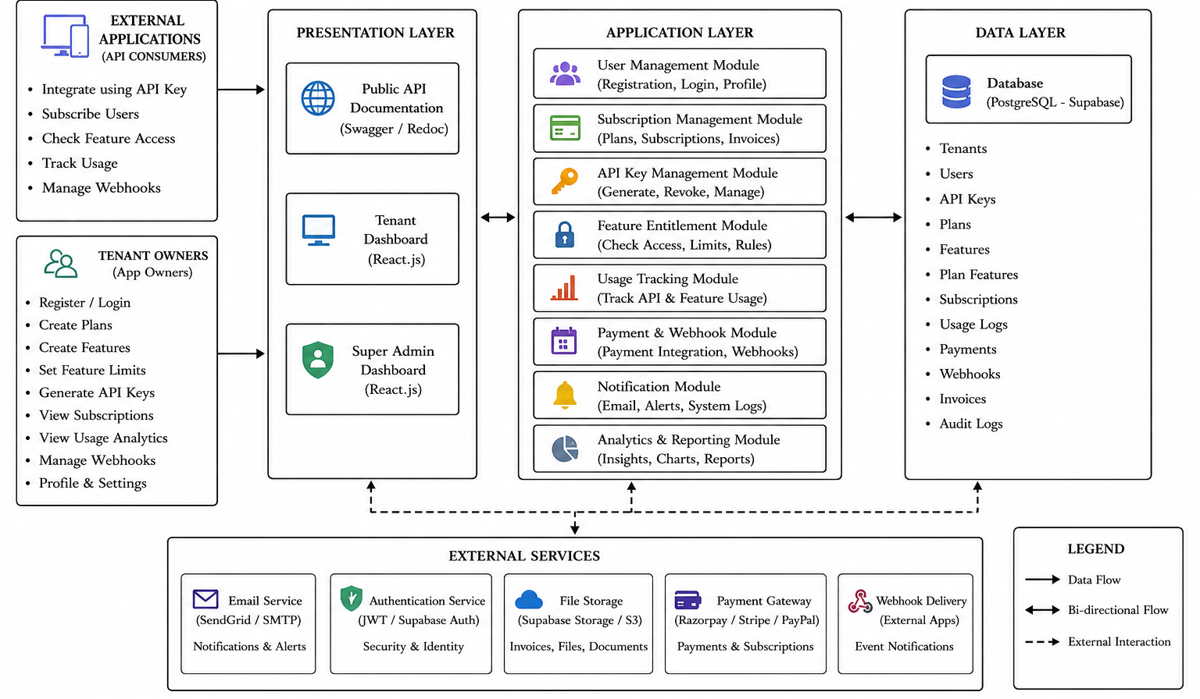
ARCHITECTURE DIAGRAM

Slide 10
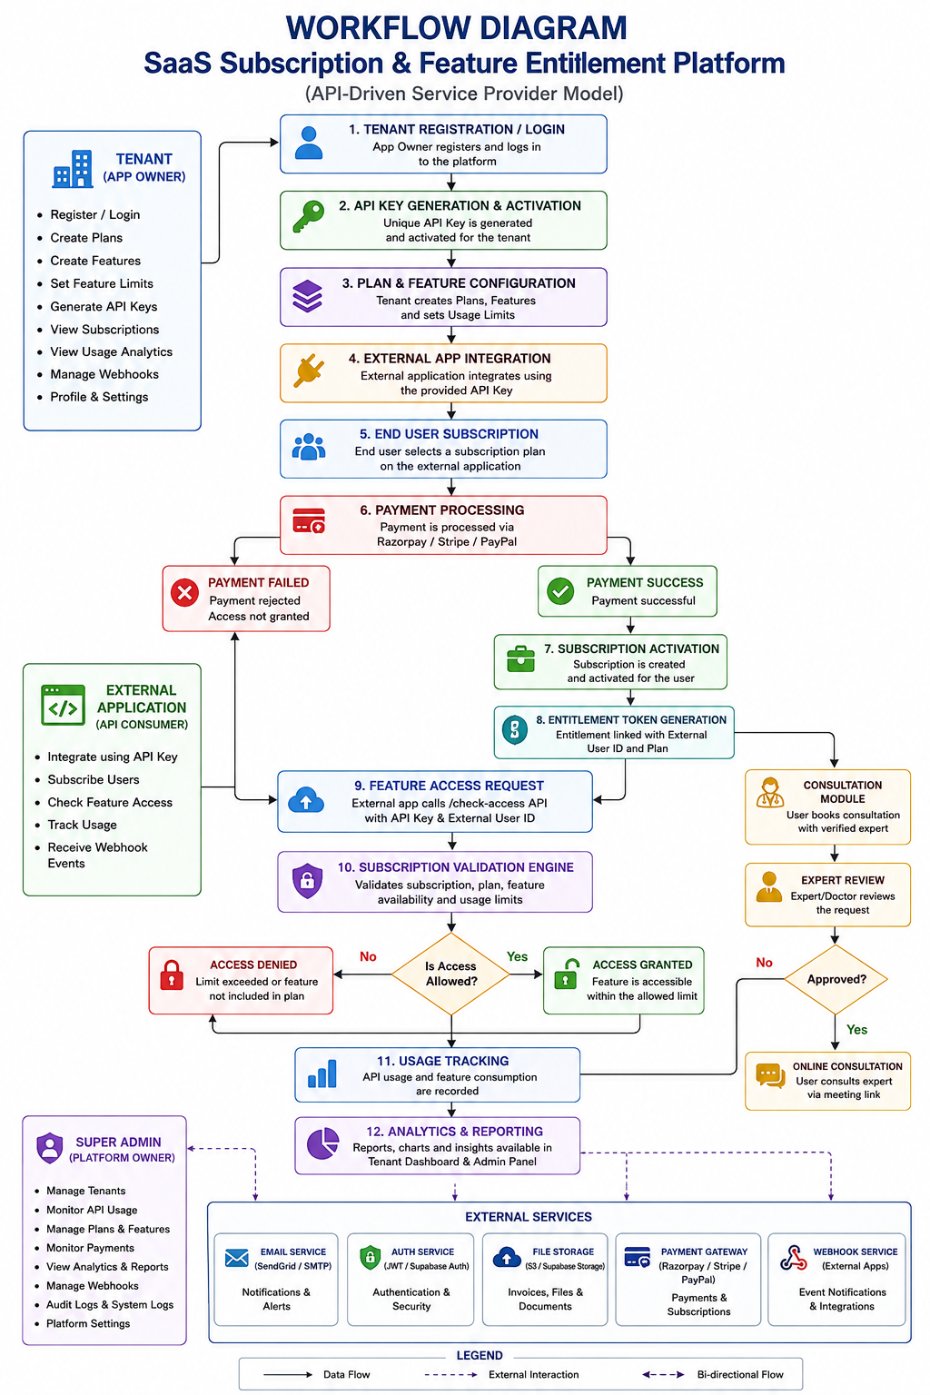
WORKFLOW DIAGRAM

Slide 11
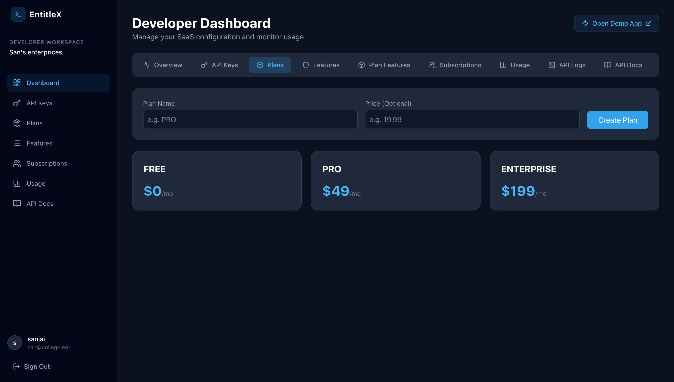
Text
Output

Slide 12
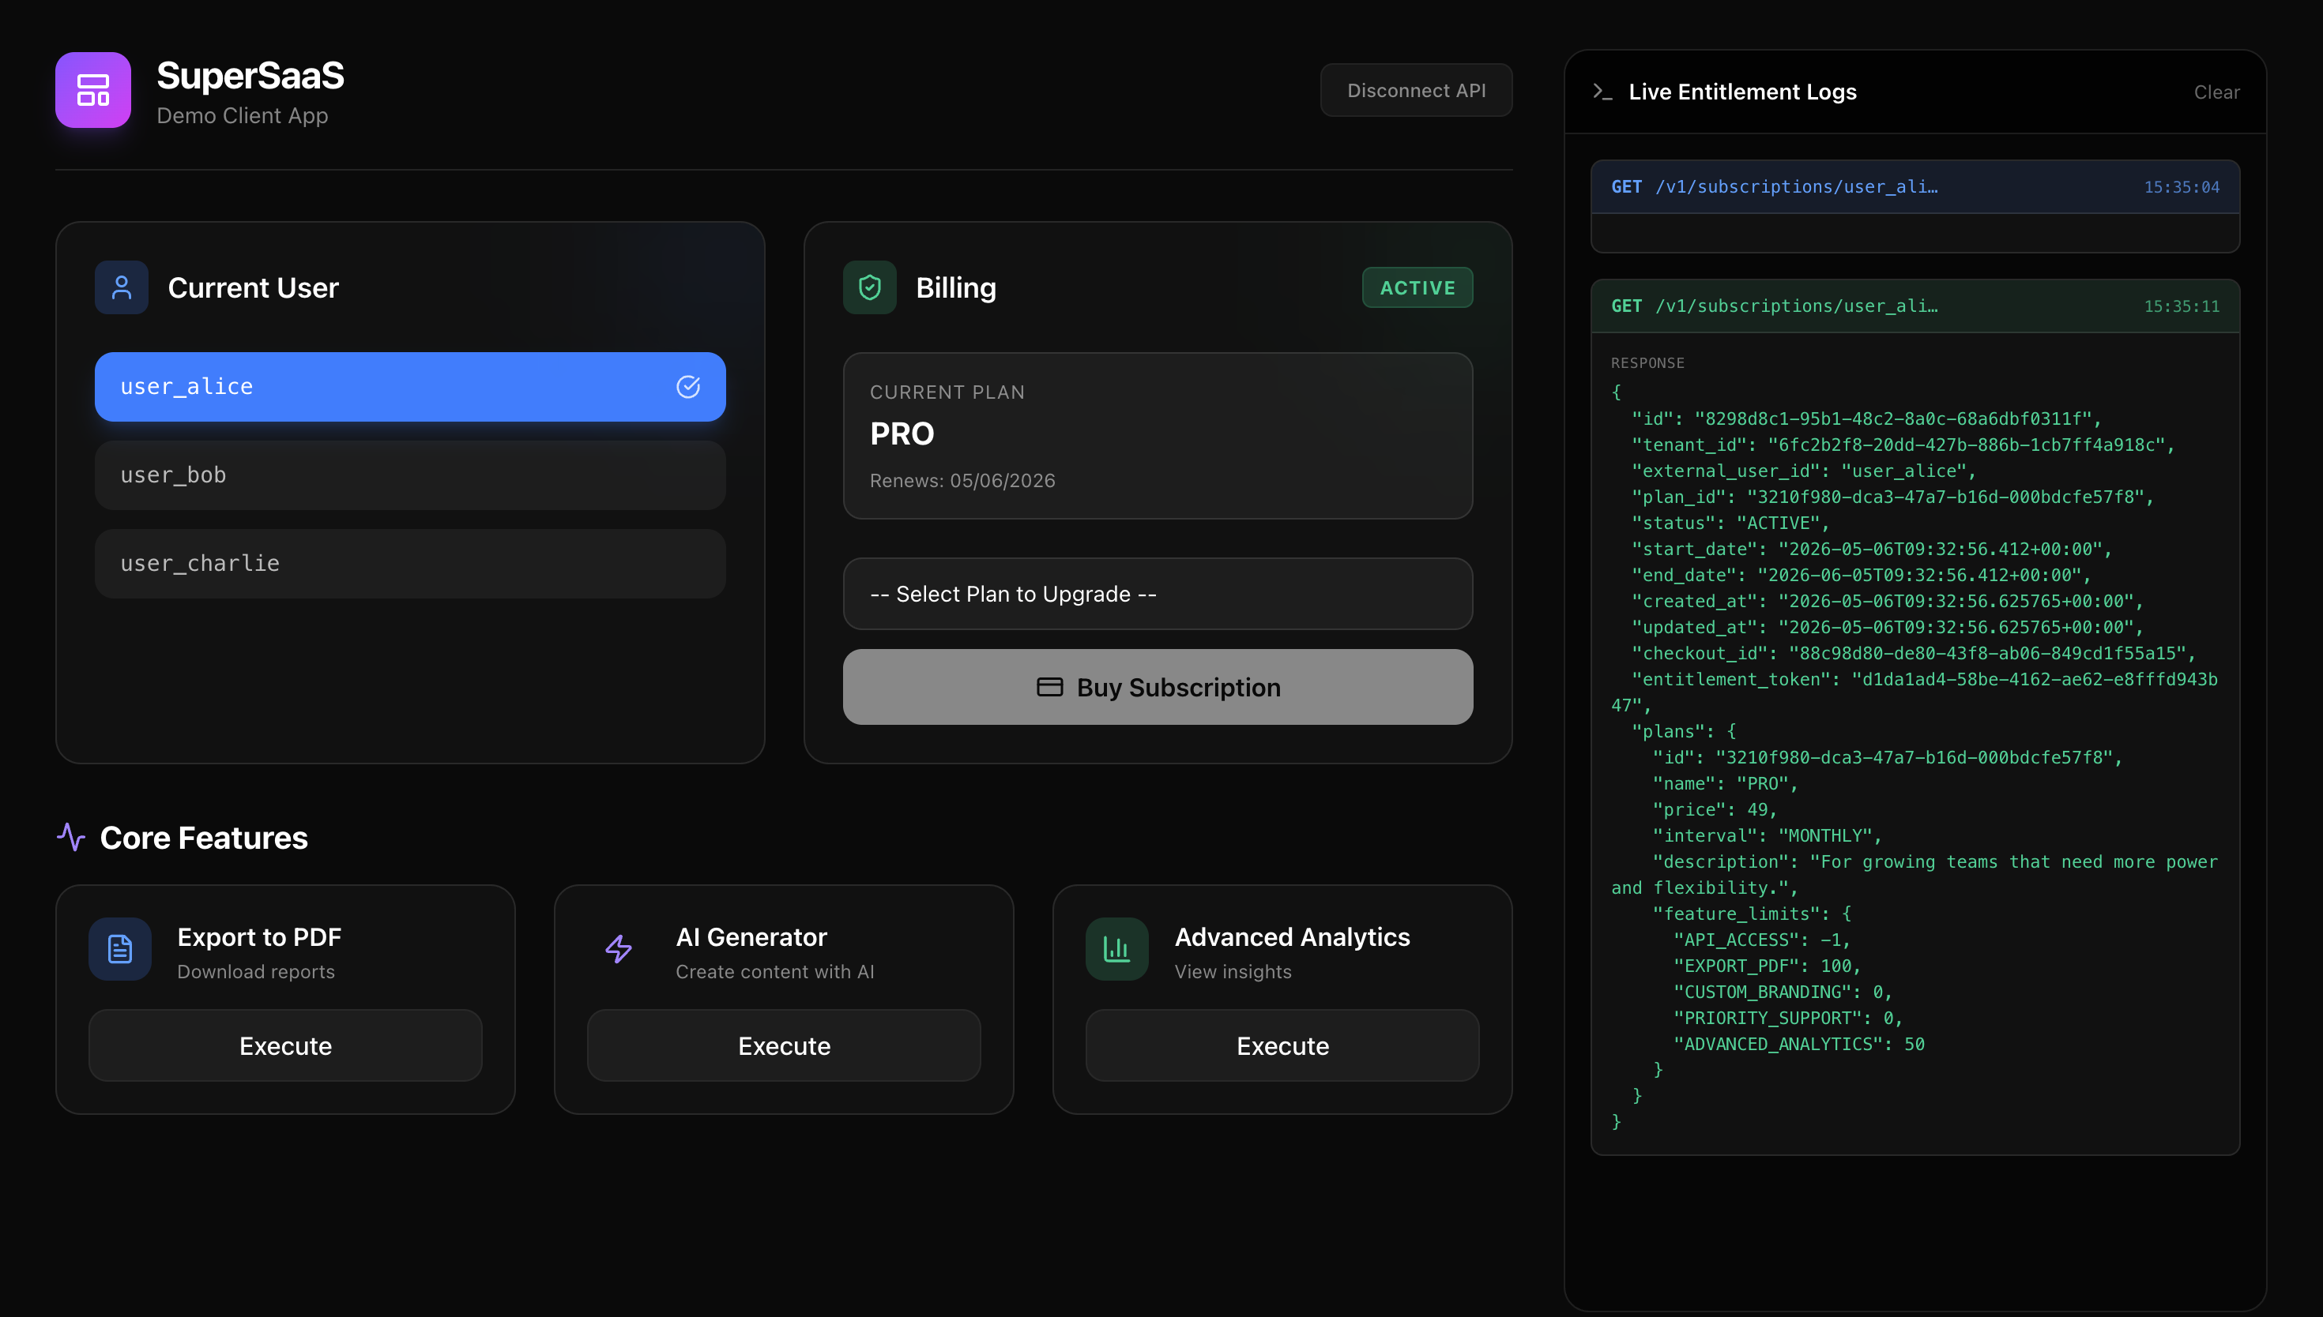
Text
Output

Slide 13
CONCLUSION
The SaaS Subscription & Feature Entitlement Platform provides a scalable and secure API-driven infrastructure for managing subscriptions and feature access across multiple applications. The system simplifies SaaS development by centralizing subscription lifecycle management, entitlement verification, and usage tracking into a reusable service platform. With multi-tenant architecture and real-time API validation, the project offers a modern solution for scalable SaaS product development.

Slide 14
FUTURE SCOPE
AI-based subscription recommendations
Real-time billing automation
Advanced analytics dashboards
Mobile SDK integration
Multi-currency payment support
OAuth and SSO authentication
Webhook automation system
Enterprise SaaS scaling support

Slide 15
REFERENCES
Sharma, R., & Gupta, A. (2021). API-Driven SaaS Subscription Management System for Multi-Tenant Applications. International Journal of Computer Applications.
Kumar, S., & Patel, D. (2022). Feature Entitlement and Usage Tracking Mechanisms in Cloud-Based SaaS Platforms. International Journal of Advanced Research in Computer Science.
Singh, P., & Verma, R. (2020). Secure API Key Authentication and Role-Based Access Control for SaaS Systems. Journal of Information Security and Applications.
Mehta, K., & Joshi, M. (2023). Subscription Billing and Webhook Integration in Modern SaaS Architectures. International Journal of Information Systems and Technology.
Rao, V., & Nair, S. (2019). Multi-Tenant SaaS Platform Design Using REST APIs and Cloud Infrastructure. International Journal of Software Engineering and Applications.

